Slide 1

Instability as a Data Quality Issue in Wikipedia Evidence from Diversity-Related Topics in English Wikipedia
Anju Yamada
KODAQS Cohort 2; Assignment

Slide 2
1. Introduction

Slide 3

Wikipedia as a Dynamic Data System
Wikipedia articles are continuously revised over time
Revision history reveals temporal variation in data quality
Sources: Moás & Lopes (2024); Raman et al. (2020); Zeng et al. (2006)

Slide 4
Previous Literature
Previous Literature
Social Interaction and Conflict
Editing is shaped by collaboration and disagreement
Mutual reverts signal contested knowledge production (Sumi & Yasseri, 2011)
Temporal Dynamics (Burstiness)
Human activity is uneven and temporally concentrated
Wikipedia editing follows bursty patterns (Barabási, 2005; Choi et al., 2021)
Bias and Topic-Specific Dynamics
Systematic biases exist (e.g., gender, diversity)
Diversity-related topics receive uneven attention (Reagle & Rhue, 2011; Graells-Garrido et al., 2015; Sun &Peng, 2021)

Slide 5
Research Gap
What prior research focuses on
Content quality (accuracy, bias)
Revision metrics (edits, reverts)
Conflict or burstiness, often separately
What is missing
Temporal stability as a data quality issue
Topic-specific instability in diversity-related pages
This study
Treats instability as a data quality problem
Compares structural, temporal, and revert-related instability

Slide 6
2. Data and Research Design

Slide 7
Data Sources and Definition
Data : English Wikipedia
Largest and most studied edition
Sources
Page metadata → topic classification
Edit logs → edits, reverts, timestamps
Pageviews → external attention
Key Definition
Diversity-related pages: Label: Culture.Biography.Women
Baseline : Other Wikipedia pages

Slide 8
Research Questions and Hypothesis
RQ1 Are diversity-related pages more unstable?
RQ2 What type of instability dominates?
H1 (structural instability): higher edit concentration
H2 (temporal instability): higher burst-day rates
H3 (revert-related instability): higher reverted edit share
RQ3 How can instability be mitigated?

Slide 9
Types of Instability in RQ1 & RQ2
Structural instability (page level) → concentration of edits within a small number of days (H1)
Temporal instability (day level) → burst-day rates within a page (H2)
Revert-related instability → share of reverted edits (editorial conflict) (H3)

Slide 10
3. Structural Instability at the Page Level (H1, RQ1 & RQ2)

Slide 11
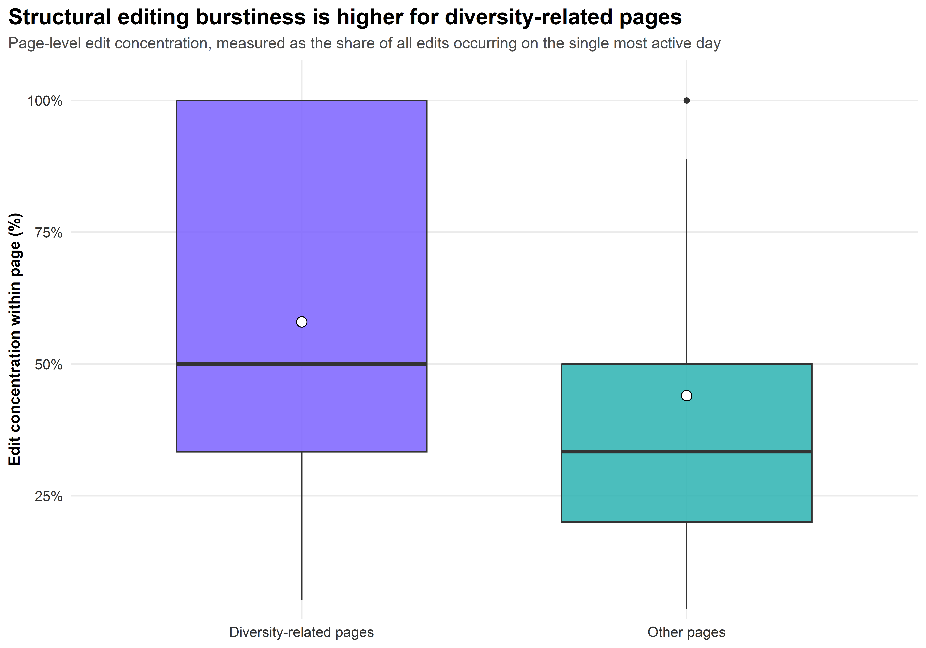
Structural Instability
Diversity-related pages show higher structural instability This supports H1
→ Evidence for RQ1: diversity pages are more unstable
→ Suggests for RQ2: instability is driven by temporal concentration

Slide 12
4.Temporal Instability at the Day Level (H2, RQ1 & RQ2)

Slide 13
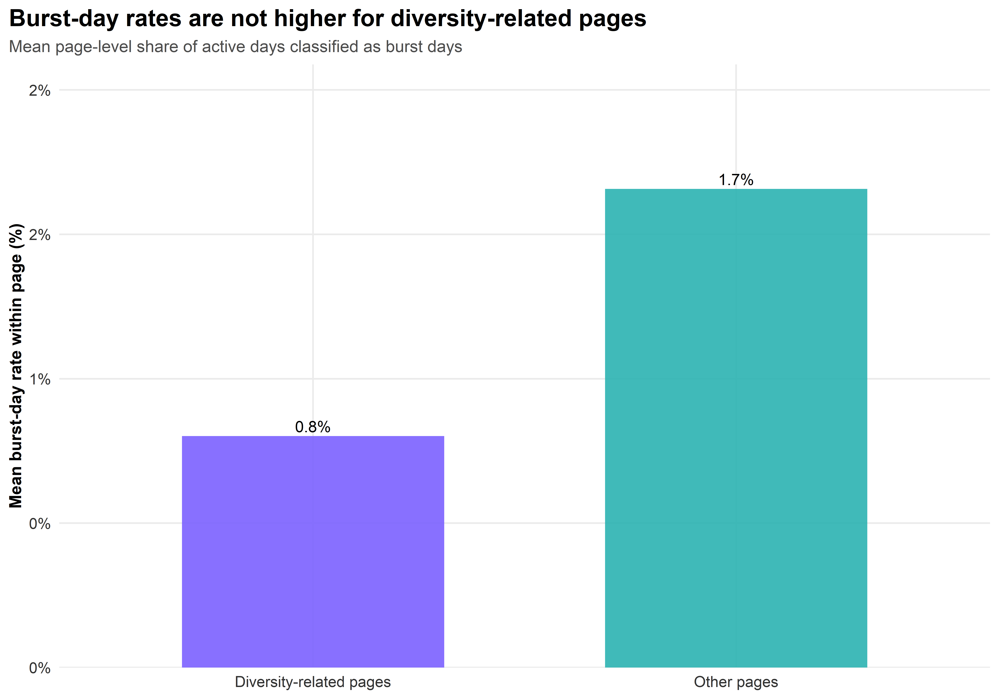
Temporal instability
Diversity-related pages show lower burst-day rates (0.8% vs 1.7%)
H2 not supported
→ RQ1: No (not more unstable in this dimension) → RQ2: instability is not driven by frequent bursts

Slide 14
5. Revert-related Instability (H3, RQ1 & RQ2)

Slide 15
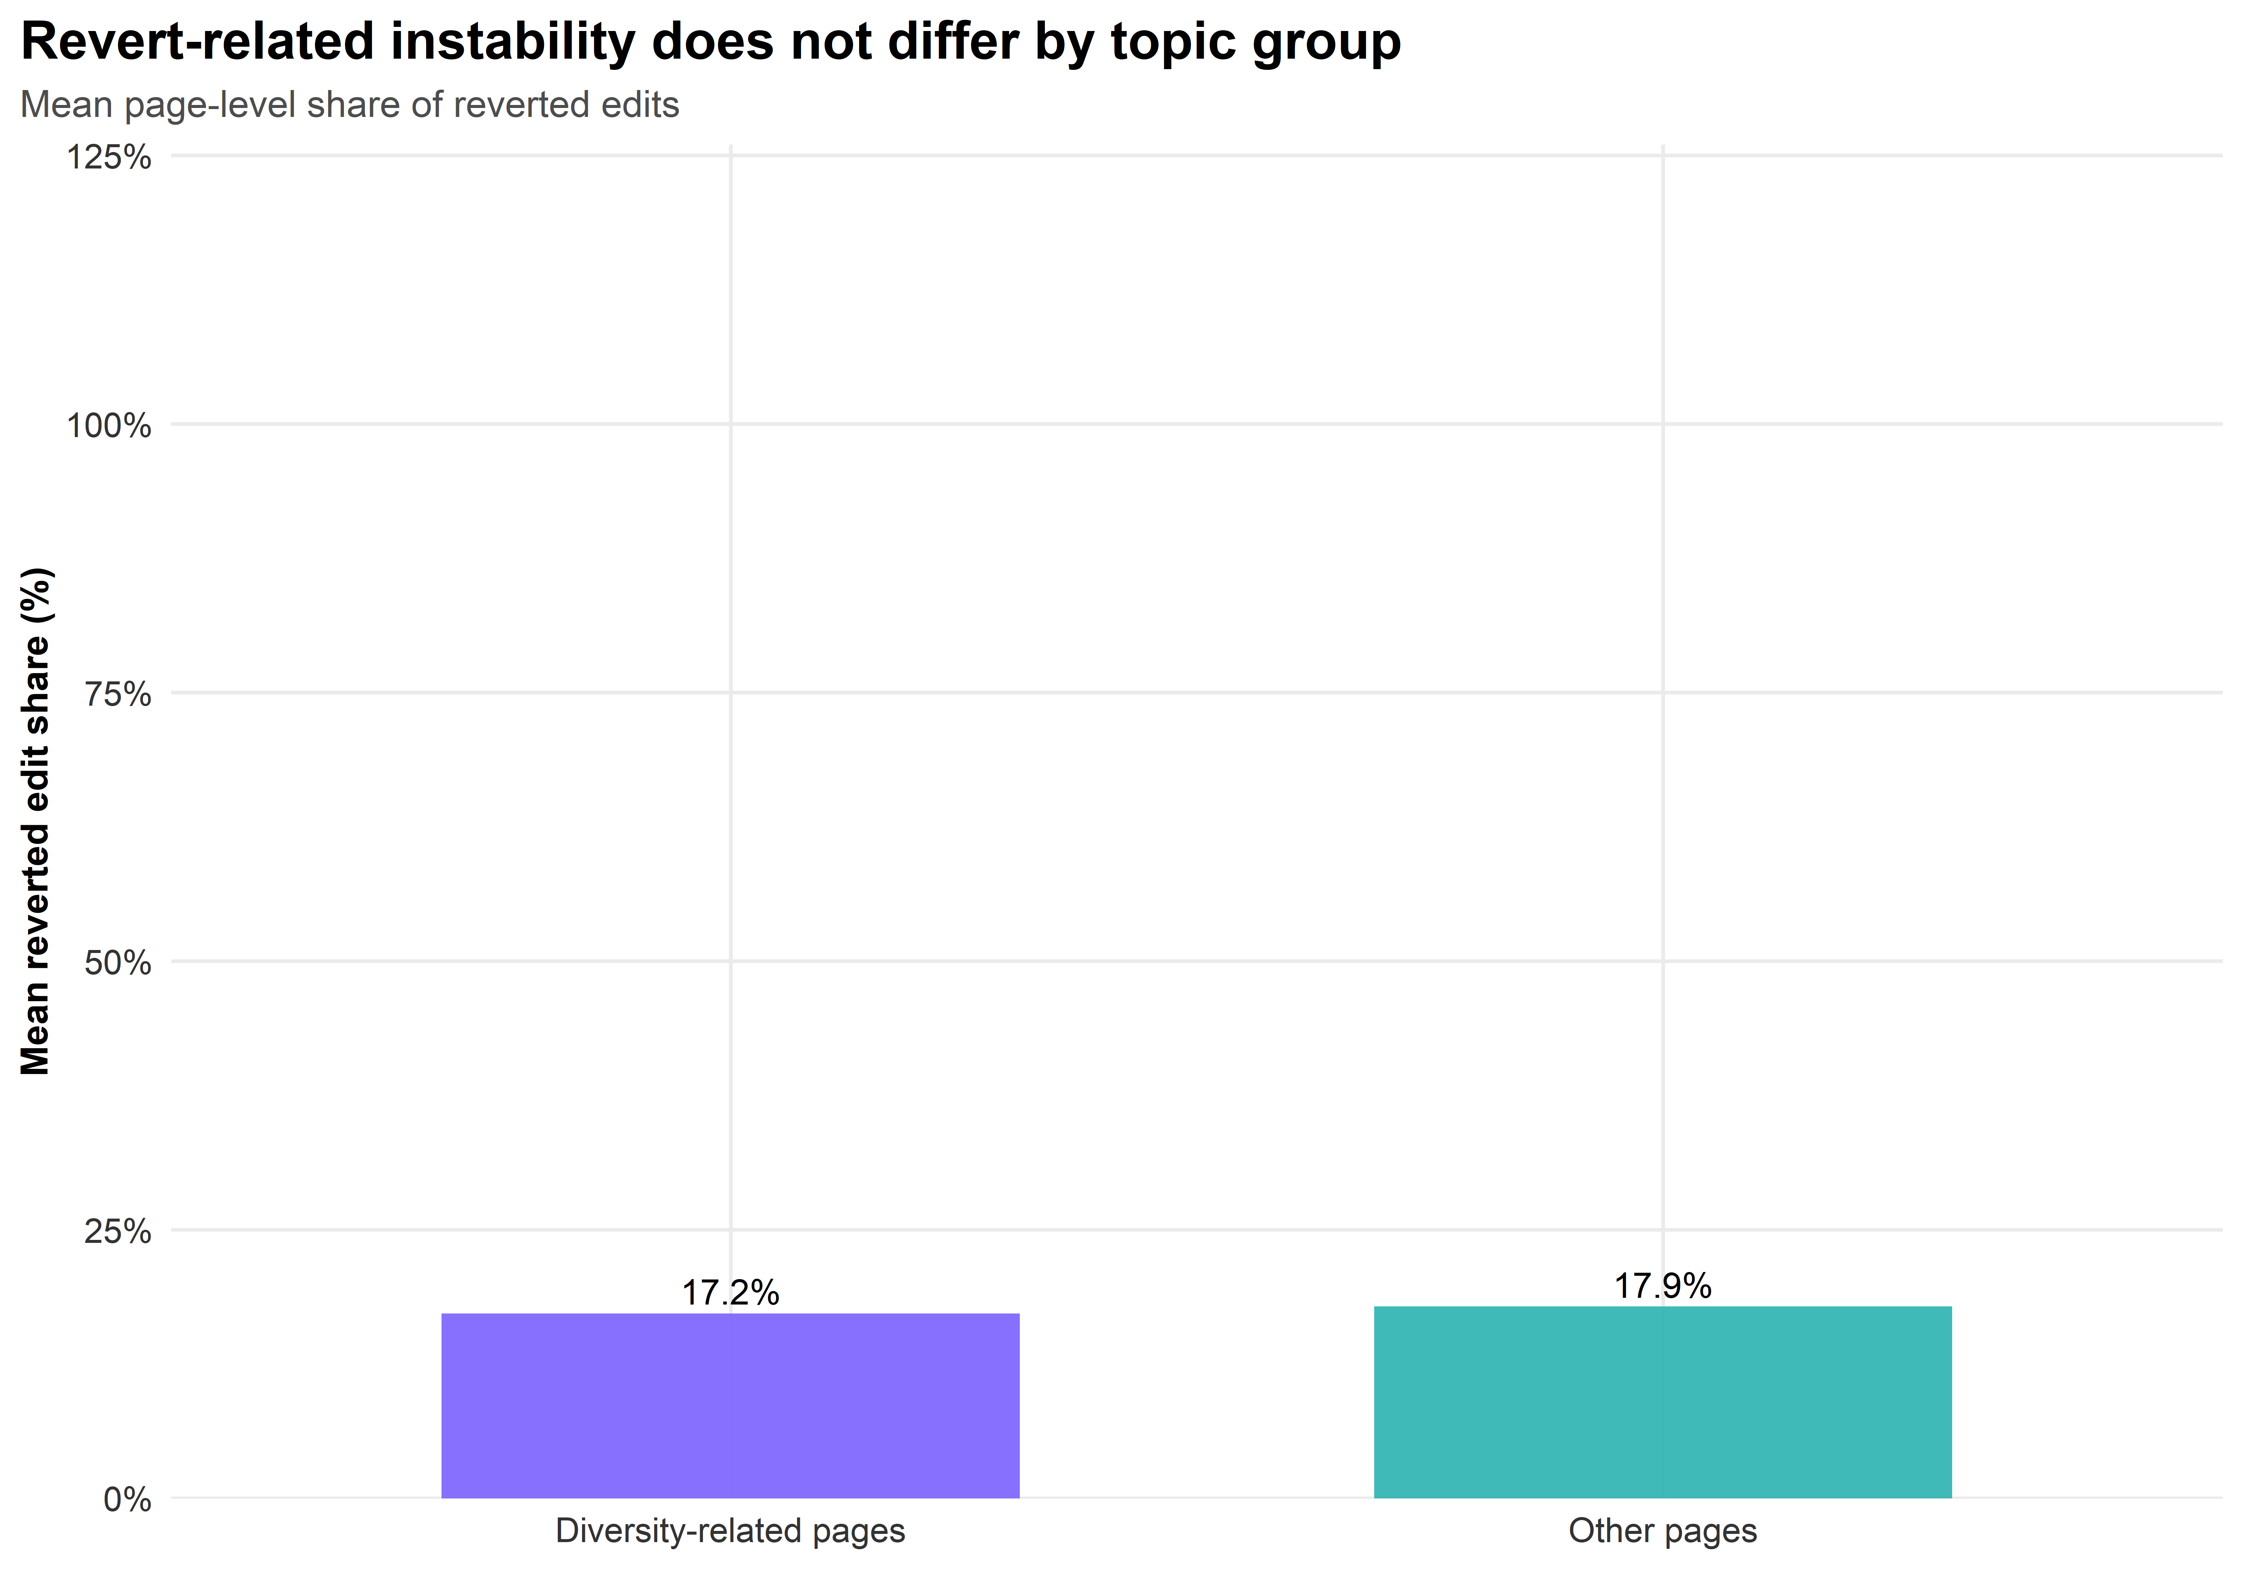
Revert-related instability
• No difference in revert-related instability (17.2% vs 17.9%)
H3 not supported
→ RQ1: No difference in this dimension → RQ2: instability is not driven by conflict

Slide 16
6. Mitigation Strategies

Slide 17
Mitigation Strategies
Use three strategies
1) Burst weighted → weight = 1 / (1 + edit_burst) → high-burst pages have less influence on averages
2) Event-day trimmed → remove burst days → recompute page-level metrics
3) Combined → trim burst days + apply burst weighting
Then, evaluate their effects on structural instability, the main dimension along which diversity-related pages differ.

Slide 18
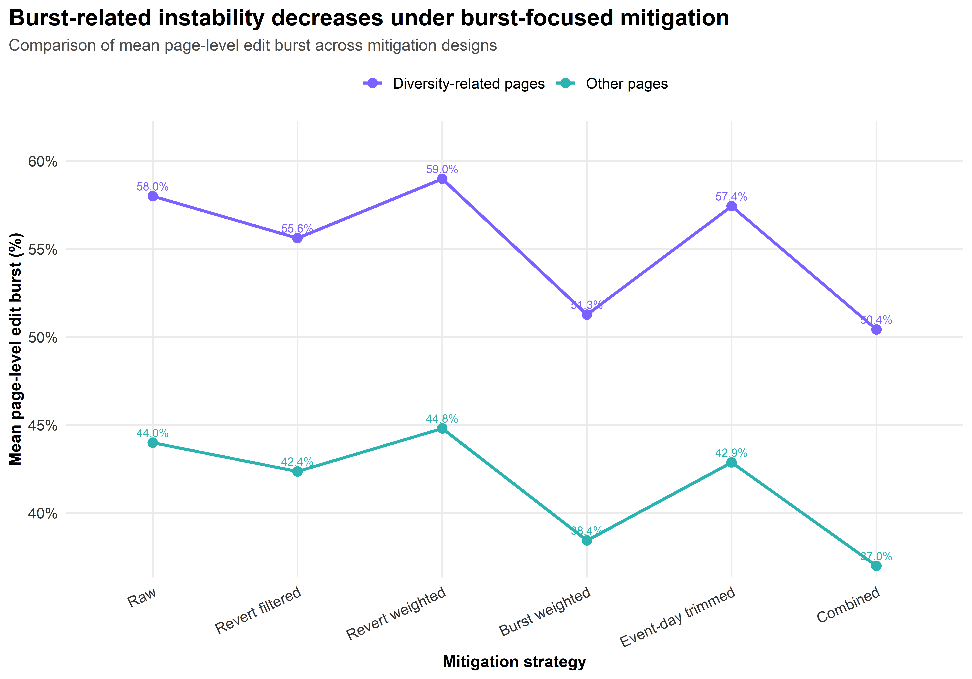
Mitigation Strategy on Structural Instability
Burst-related instability
= Editing is concentrated in a short period
Y-axis: Mean Burst Measure (%)
=Share of edits concentrated in the most active day
Lower values → content is more stable and consistent
Key Result
Event-day trimming → strongest effect
Notes:
Burst-related instability
= Editing is concentrated in a short period

Slide 19
7. Discussion and Conclusion

Slide 20
Summary
Key Insight
Instability has multiple dimensions:
Conflict (reverts)
Temporal concentration (burstiness)
Result
Burst-based methods → fix temporal instability
Revert-based methods → fix conflict-related instability
Conclusion
Effective mitigation requires dimension-specific strategies

